Slide 1
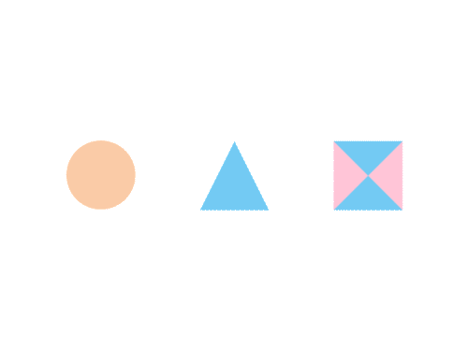

CSE 591 Graphs and Networks
Ross Maciejewski
rmacieje@asu.edu

Slide 2
Connections
Past lectures, we’ve talked about multivariate data
Time series (line plots, cyclical, control chart, prediction)
Geographic (choropleth maps, spatial autocorrelation)
In these data, we’re seeing connections between events, locations and time
However, there are other ways to represent these sorts of connections
We can model a set of connections as a graph

Slide 3
What is a Graph?
Vertices (nodes) connected by Edges (links)
We have several ways to represent a graph
Adjacency list
Adjacency matrix (this is analogous to the weights matrix in last lecture)
Adjacency List
1:3
2:3
3:1,2
2
1
3
 | 1 | 2 | 3
1 | 0 | 0 | 1
2 | 0 | 0 | 1
3 | 1 | 1 | 0

Slide 4
Graph Representations
Adjacency list representation is usually preferred because it provides the most compact way to represent sparse graphs
Sparse graph: |E|<<|V|²
Adjacency matrix representation may be preferred for a highly connected graph

Slide 5
Graph Terminology
Graphs can have cycles – meaning that you can follow a path from one node and return back to the same node
Graph edges can be directed or undirected – think of this as a one-way street (directed) or a two-way street (you can go either direction)
The degree of a vertex is the number of edges connected to it
For a directed graph, you have an In-Degree and an Out-Degree
Graph edges can have values (weights) on them and these values can be measures like we’ve discussed in our multivariate data (nominal, ordinal or quantitative)
Some details from this slide borrowed from John Stasko’s Graph lecture: http://www.cc.gatech.edu/~stasko/7450/Notes/graph1.pdf

Slide 6
Graph Drawing
There is a whole research community that focuses on the creation of graph layout techniques: http://www.gd2012.org/
1970s
Begin to visualize graphs on a computer
Inspired by the need for better decision making
Key Ideas:
Aesthetics in the graph layouts
Can we mathematically optimize these “aesthetics”

Slide 7
Graph Drawing
1980s
Exciting algorithms and geometry
Many fundamental graph layout algorithms are developed
Inspired by graph theory, geometry
Planarity becomes a key concept
A planar graph is a graph that can be embedded in a plane so that no edges intersect (there is a puzzle computer game of the same name)
The problem of determining if a graph is planar can be solved in linear time with a simple algorithm
Fary’s Theorem (1948) – any simple planar graph can be drawn without crossings so that its edges are straight line segments
Fáry, István (1948), "On straight-line representation of planar graphs", Acta Sci. Math. (Szeged) 11: 229–233

Slide 8
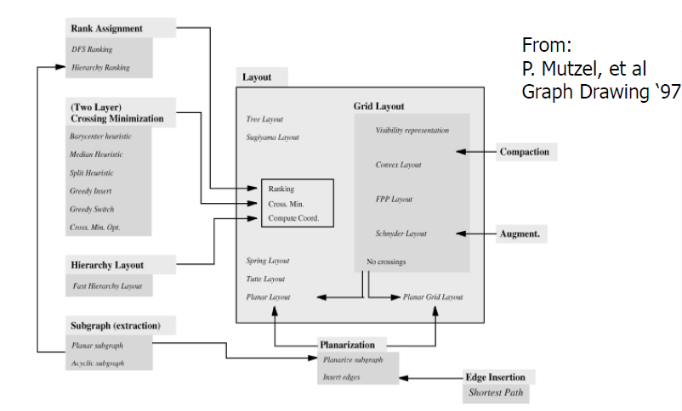
Graph Layouts

Slide 9
Graph Drawing
1990s
Graph drawing matures as a discipline with the advent of the graph drawing conference
Information visualization emerges as a discipline
2000s
More demand for graph drawing
Data volumes become larger – data deluge
More usable products, faster computers
New customers (social networks, systems biology, security)

Slide 10
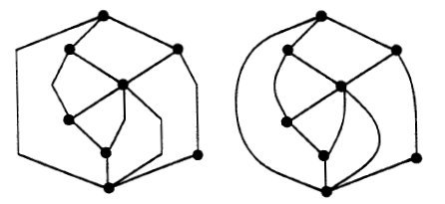
How to Draw a Graph?
Various graphic standards have been proposed for the representations
Vertices are typically circles or boxes and edges are a simple curve
So, a graph drawing algorithm takes in the edges and vertices of a graph and outputs a pictorial representation based on some algorithmic graphic standard

Slide 11
How to Draw a Graph?
A graph has infinitely many ways to be laid out
What we are concerned with is the usefulness of the drawing or the capability of conveying the meaning and relationships
These are often expressed by means of aesthetics
A fundamental and classic aesthetic is the minimization of edge crossings
Might want to minimize the area on the screen that the graph takes up
May want to optimize displays of symmetry
P Eades and R Tamassia, “Algorithms for Drawing Graphs: An Annotated Bibliography,” Technical Report No. CS-89-09, Brown University, October 1989.

Slide 12
Aesthetic Considerations
Crossings – minimize towards planar
Total edge length – minimize towards proper scale
Area – minimize towards efficiency
Maximum edge length – minimize longest edge
Uniform edge length – minimize variance
Total bends – minimize orthogonal towards straight-line
Some details from this slide borrowed from John Stasko’s Graph lecture: http://www.cc.gatech.edu/~stasko/7450/Notes/graph1.pdf

Slide 13
Experimenting with Aesthetics-Based Graph Layout
Automatic graph layout algorithms are judged on typically two things
Speed
Extent to which they conform to an aesthetic (minimized crossings, maximized symmetry, etc.)
However, we want to understand if humans can use these
Helen Purchase preformed a series of experiments to explore this
Experiments showed that reducing the number of crossing is the most important aesthetic to consider
Purchase, H.C.; Carrington, D.; Allder, J.-A. Experimenting with aesthetics-based graph layout. In: Anderson, M.; Cheng, P.; Haarslev, V., editors. Vol. LNAI 1889, Theory and Application of Diagrams Conference: Springer Verlag; 2000. p. 498-501

Slide 14
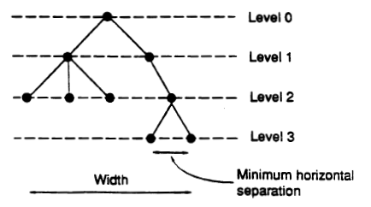
Rooted Trees
A graph might be used to represent some hierarchy, so we often utilize a tree metaphor
Typically these utilize the following aesthetics
Vertices are placed along horizontal lines according to their level (distance from root)
There is a minimum separation distance between two consecutive vertices on the same level
The width of the drawing is as small as possible
P Eades and R Tamassia, “Algorithms for Drawing Graphs: An Annotated Bibliography,” Technical Report No. CS-89-09, Brown University, October 1989.

Slide 15
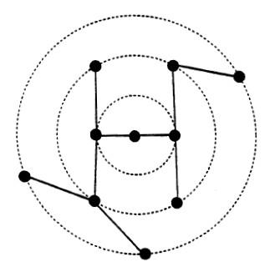
Free Trees
We can have trees that do not represent hierarchy
Modify rooted trees to produce radial drawing by arranging the vertices of each level on a concentric circle
It is NP-complete to construct a planar orthogonal grid drawing of a tree such that the maximum edge length is minimized
P Eades and R Tamassia, “Algorithms for Drawing Graphs: An Annotated Bibliography,” Technical Report No. CS-89-09, Brown University, October 1989.

Slide 16
Planarity Testing
Clearly, one aesthetic is to remove line crossing, thus planarity is a desirable graph feature
This is a well-studied problem, and many methods exist that run in O(n) time where n is the number of edges (or vertices) in a graph
Classic path addition method¹
PQ tree vertex addition method²
Edge addition method³
The source code for such planarity tests are publicly available online: http://www.ogdf.net/doku.php
1 - Hopcroft, John; Tarjan, Robert E. (1974), "Efficient planarity testing", Journal of the Association for Computing Machinery 21 (4): 549–568
2 - Lempel, A.; Even, S.; Cederbaum, I. (1967), "An algorithm for planarity testing of graphs", in Rosenstiehl, P., Theory of Graphs, New York: Gordon and Breach, pp. 215–232.
3 - Boyer & Myrvold (2004), p. 243: “Its implementation in LEDA is slower than LEDA implementations of many other O(n)-time planarity algorithms.”

Slide 17
Straight Line Graph Drawings
Tutte’s Algorithm
Fix one face of a simple, planar, 3-connected graph in convex position
Place each other vertex at the barycenter (centroid) of its neighbors
The result is a non-crossing, convex drawing
William T. Tutte. How to draw a graph. Proc. London Math. Society, 13(52):743–768, 1963.

Slide 18
Orthogonal Grid Drawings
Planar orthogonal grid drawings were first studied in connection with circuit layout
With this graphic standard, goal is to minimize the number of bends (good for readability and for VLSI)
Any planar graph of degree at most 4 admits a planar orthogonal grid drawing with area O(n²)
P Eades and R Tamassia, “Algorithms for Drawing Graphs: An Annotated Bibliography,” Technical Report No. CS-89-09, Brown University, October 1989.

Slide 19
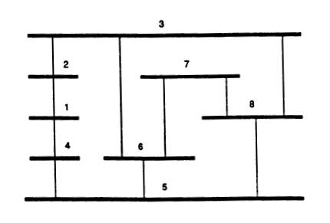
Visibility Representations
A visibility representation for a planar graph G consists of representing the vertices of G by horizontal segments, and the edges of G by vertical segments so that the edge-segment associated with each edge (u,v) intersects exactly the vertex-segments associated with u and v, and no other vertex-segment
P Eades and R Tamassia, “Algorithms for Drawing Graphs: An Annotated Bibliography,” Technical Report No. CS-89-09, Brown University, October 1989.

Slide 20
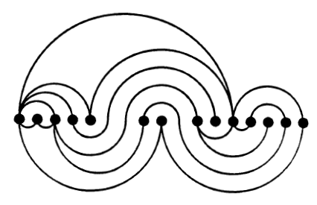
Planar Drawings on a Line
P Eades and R Tamassia, “Algorithms for Drawing Graphs: An Annotated Bibliography,” Technical Report No. CS-89-09, Brown University, October 1989.

Slide 21
Force-Directed Methods
Use a physical analogy to draw graphs
View a graph as a system of objects with forces acting between them
Assumption is that a balanced system gives a good layout
Specifically, a system configuration with locally minimum energy
The sum of forces on each object is zero

Slide 22
Force-Directed Methods
Consider each node/vertex to be the object of the system
The nodes interact with each other based on some forces
Edges do not interact with each other, instead, they add new forces to each node
Equilibrium configuration is when the sum of forces on each node is zero
Methods typically have two parts
Model – a force system defined by vertices and edges
Algorithm – a technique for finding equilibrium

Slide 23
Spring Methods
Vertex
Thought of as an electrically charge particle that repels each other
Edge
Thought of as a spring that connects the particles
So there is an attraction force when longer than the natural length, and repulsion when shorter
1.
2.

Slide 24
Springs and Electrical Forces
Use a combination of spring & electrical forces
Edge: modeled as spring
Vertex: equally charged particles which repel each other
The force on v : F(v) = Σ f _{u,v} + Σ g _{u,v}
f _{u,v} : force on v by the spring between u an v
: follow Hook’s law (proportional to the difference between the distance between u and v and the zero-energy length of the spring)
g _{u,v} : Electrical repulsion exerted on v by vertex u
: follow inverse square law

Slide 25
Springs and Electrical Forces
d(p,q) : Euclidean distance between points p and q
p_{v} = (x_{v}, y_{v}): position of vertex v
x component of the force on v
l_{u,v} : natural (zero energy) length of the spring between u and v
: if the spring has natural length l_{u,v}, no force is exerted;
k¹_{u,v} : stiffness of the spring between u and v
: the larger k¹_{u,v} , the more tendency for the distance between u and v to be close to l_{u,v.}
k²_{u,v} : the strength of the electrical repulsion between u and v

Slide 26
Springs and Electrical Forces
Aim of the force model design:
Spring force:
Ensure the distance between adjacent vertices u and v is approximately equal to l_{u,v}.
Electrical force:
Ensure vertices not too close to each other.
One may choose parameters l_{uv} k¹_{u,v} k²_{u,v} to customize for specific applications.
An example: http://mbostock.github.com/d3/ex/force.html

Slide 27
Finding Equilibrium
There are many technique to find an equilibrium configuration (or minimum energy).
Simple algorithm
Initially at random location
At each iteration:
Force F(v) on each vertex is computed
Each vertex v is moved in the direction of F(v) by a small amount proportional to the magnitude of F(v)
Stops when equilibrium is achieved or some conditions are met.
Not the fastest, but allow smooth animation.
Calculating attractive forces only between neighbors: O(|E|)
Calculating repulsive forces between all pair of vertices: O(|V|²)
Bottleneck of the algorithm in general

Slide 28
Force directed methods
Many experiments in this area, but the open problem is, “Why do these methods work?”
Many experiments, some theorems
Theorem: If a graph has the right automorphisms, then there is a local minimum of a spring drawing that is symmetric
Theories
Combinatorial rigidity theory
Theory of multidimensional scaling
Details from this slide borrowed from Peter Eades’ “The Future of Graph Drawing – and a rhapsody” lecture: http://sydney.edu.au/engineering/it/~peter/downloads.html

Slide 29
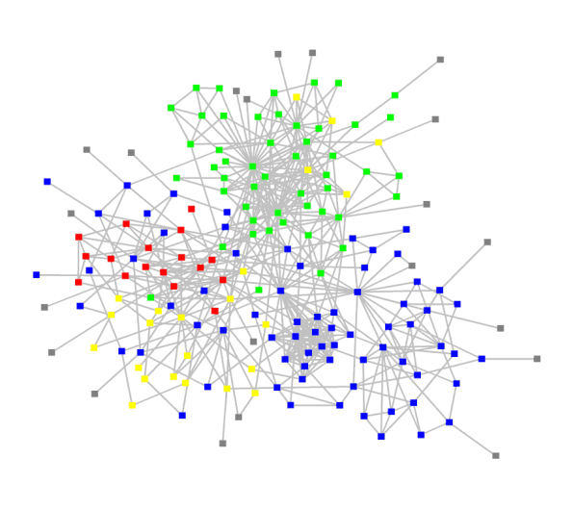
Scale Challenge
So, what happens when we get a lot of nodes and edges?
We run out of space for vertices and edges so we get a hairball
Can slow down the algorithm!

Slide 30
Expanding Graph Drawing
If we want to improve the visual capacity for graph drawing we need to think of extensions
3D
Interaction
Clustering

Slide 31
Theorems
2D Theorem: Every planar graph with maximum degree 4 admits a 2D orthogonal drawing with no edge crossing and at most 4 bends per edge (1980s)
3D Theorem: Every graph (even if it is nonplanar) with maximum degree 6 admits a 3D orthogonal drawing with no edge crossings and a constant number of bends per edge¹
1-G Di Battista, M Patrignani, F Vargiu, A split&push approach to 3D orthogonal drawing, Graph Drawing, 1998

Slide 32
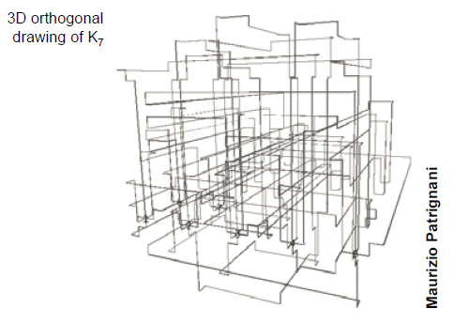
3D Graph Drawing
1990-2005
Many theorems on 3D
New metaphors introduced
New research grants and start-up company
However, 3D mostly failed

Slide 33
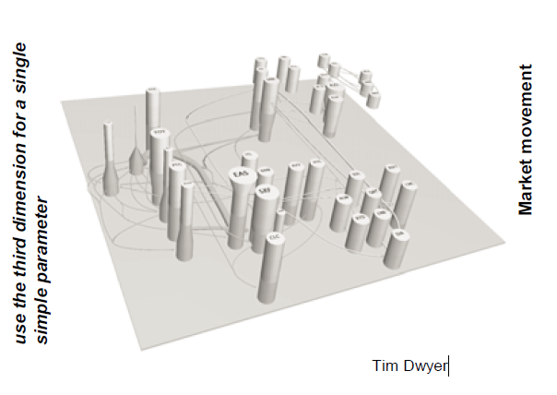
2.5D Graph Drawing
Colin Ware: “Use 3D with a 2D attitude”
Tim Dwyer: “use the third dimension for a single simple parameter”
Tim Dwyer and David R. Gallagher. Visualising changes in fund manager holdings in two and a half-dimensions. Information Visualization, 3(4):227-244, 2004

Slide 34
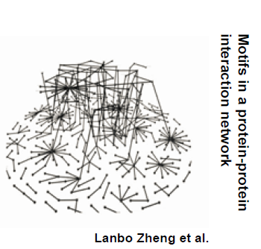
Multiplane Method
Partition the graph
Draw each part on a 2D manifold in 3D
Connect the parts with inter-manifold edges
Weidong Huang, Colin Murray, Xiaobin Shen, Le Song, Ying Xin Wu, Lanbo Zheng: Visualisation and Analysis of Network Motifs. IV 2005: 697-702

Slide 35
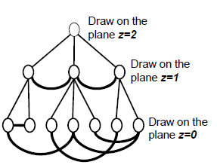
Multilevel Visualization of Clustered Graphs
Draw the clusters on height I of the cluster tree on the plane z=i
P. Eades and Q. Feng. Multilevel Visualization of Clustered Graphs. In Proc. 6th Int. Symp. Graph Drawing, volume 1190 of LNCS, pages 101{112. Springer, 1996.

Slide 36
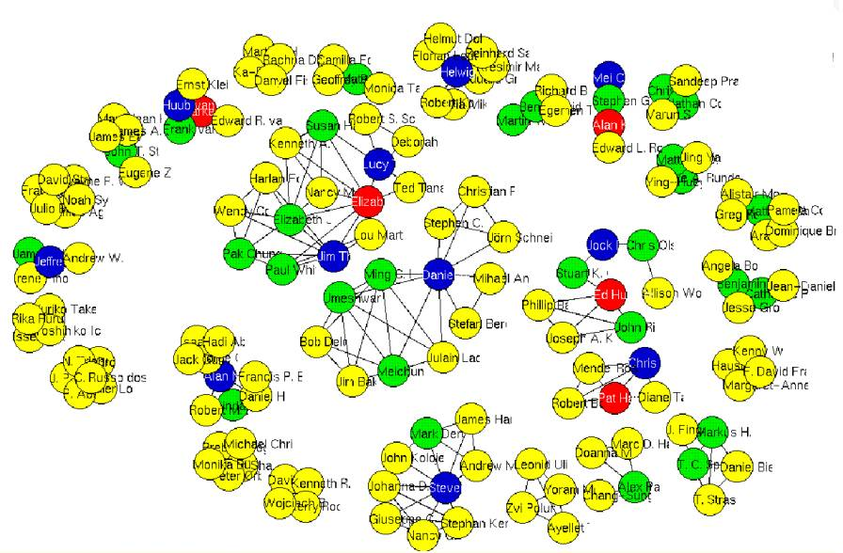
Thinking Back on our Visual Variables
If we think back onto our early lectures, we need to make decisions on what the appropriate visual variables will be
For a vertex, we have
Shape
Color
Size
Location
Label

Slide 37
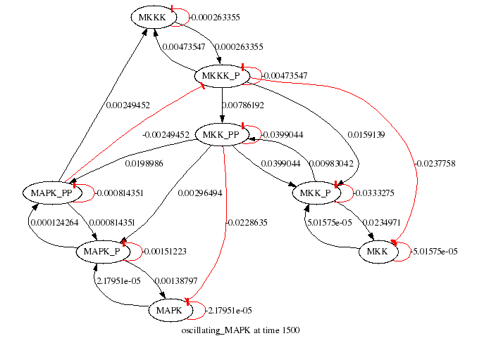
Thinking Back on our Visual Variables
For an edge, we have
Color
Size
Label
Form
Polyline
Straight
Orthogonal grid

Slide 38
Network Visualization Nirvana
What would be our dream situation for network/graph visualization?
Every node is visible
For every node, we can count its degree
For every link, you can easily follow it from source to destination
Clusters and outliers are easily identifiable
B Shneiderman and A Aris. Network Visualization by Semantic Substrates. IEEE Transactions on Visualization and Computer Graphics, 12(5): 733-740, 2006.

Slide 39
Graph Visualization Task Taxonomy
Topology-based tasks
Adjacency
Find the set of nodes adjacent to a node
Accessibility
Find the set of nodes accessible to a node
Common connection
Given nodes, find the set of nodes connected to all
Connectivity
Find shortest path
Identify clusters
Identify connected components
B. Lee, C. Plaisant, C. Sims Parr, J.-D. Fekete, N. Henry, "Task Taxonomy for Graph Visualization", Proc. of BELIV '06, April '06, pp. 1-5.
Some details from this slide borrowed from John Stasko’s Graph lecture: http://www.cc.gatech.edu/~stasko/7450/Notes/graph1.pdf

Slide 40
Graph Visualization Task Taxonomy
Attribute-based tasks
On the nodes
Find the nodes having a specific attribute value
On the edges
Given a node, find the nodes connected only by certain kinds of edges
Browsing tasks
Follow path
Revisit
Overview task
Compound exploratory task
Estimate size of a network
Find patterns
B. Lee, C. Plaisant, C. Sims Parr, J.-D. Fekete, N. Henry, "Task Taxonomy for Graph Visualization", Proc. of BELIV '06, April '06, pp. 1-5.
Some details from this slide borrowed from John Stasko’s Graph lecture: http://www.cc.gatech.edu/~stasko/7450/Notes/graph1.pdf

Slide 41
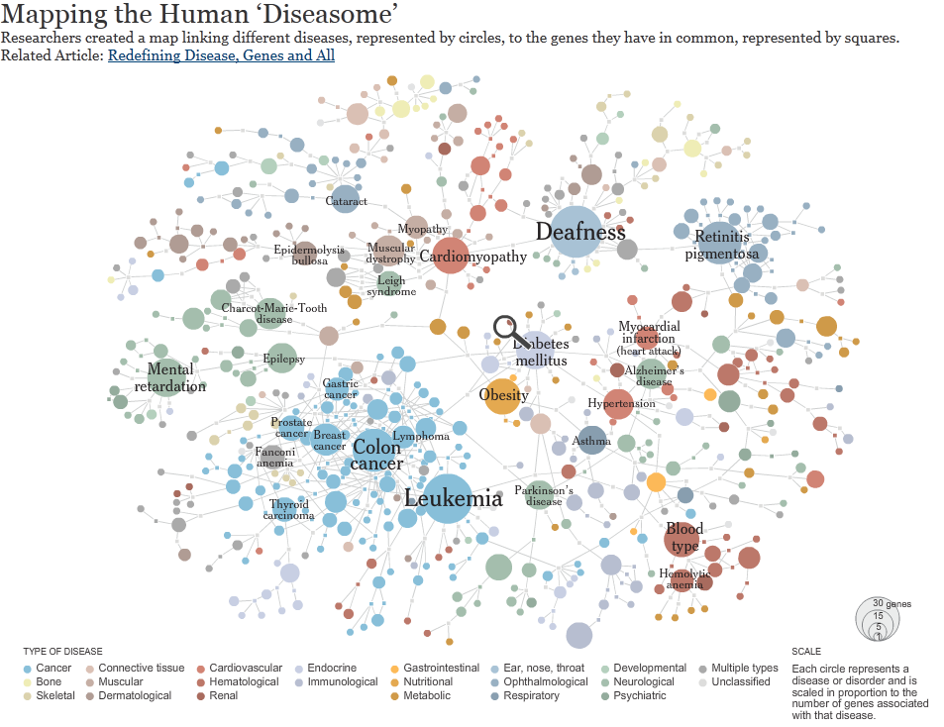
http://www.nytimes.com/interactive/2008/05/05/science/20080506_DISEASE.html

Slide 42
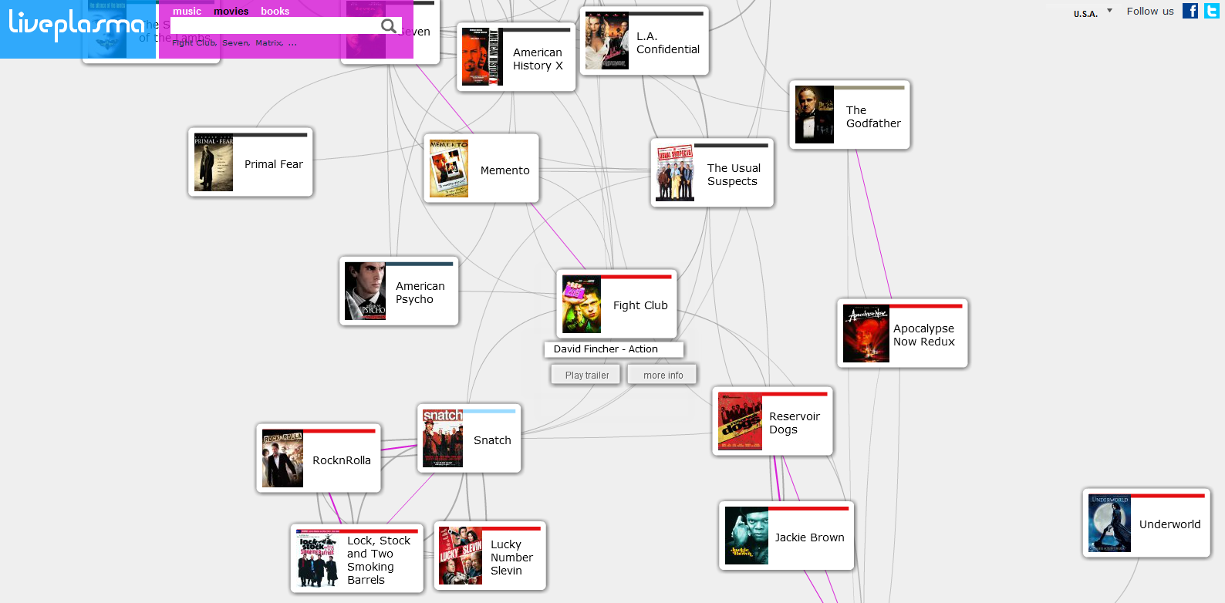

Slide 43
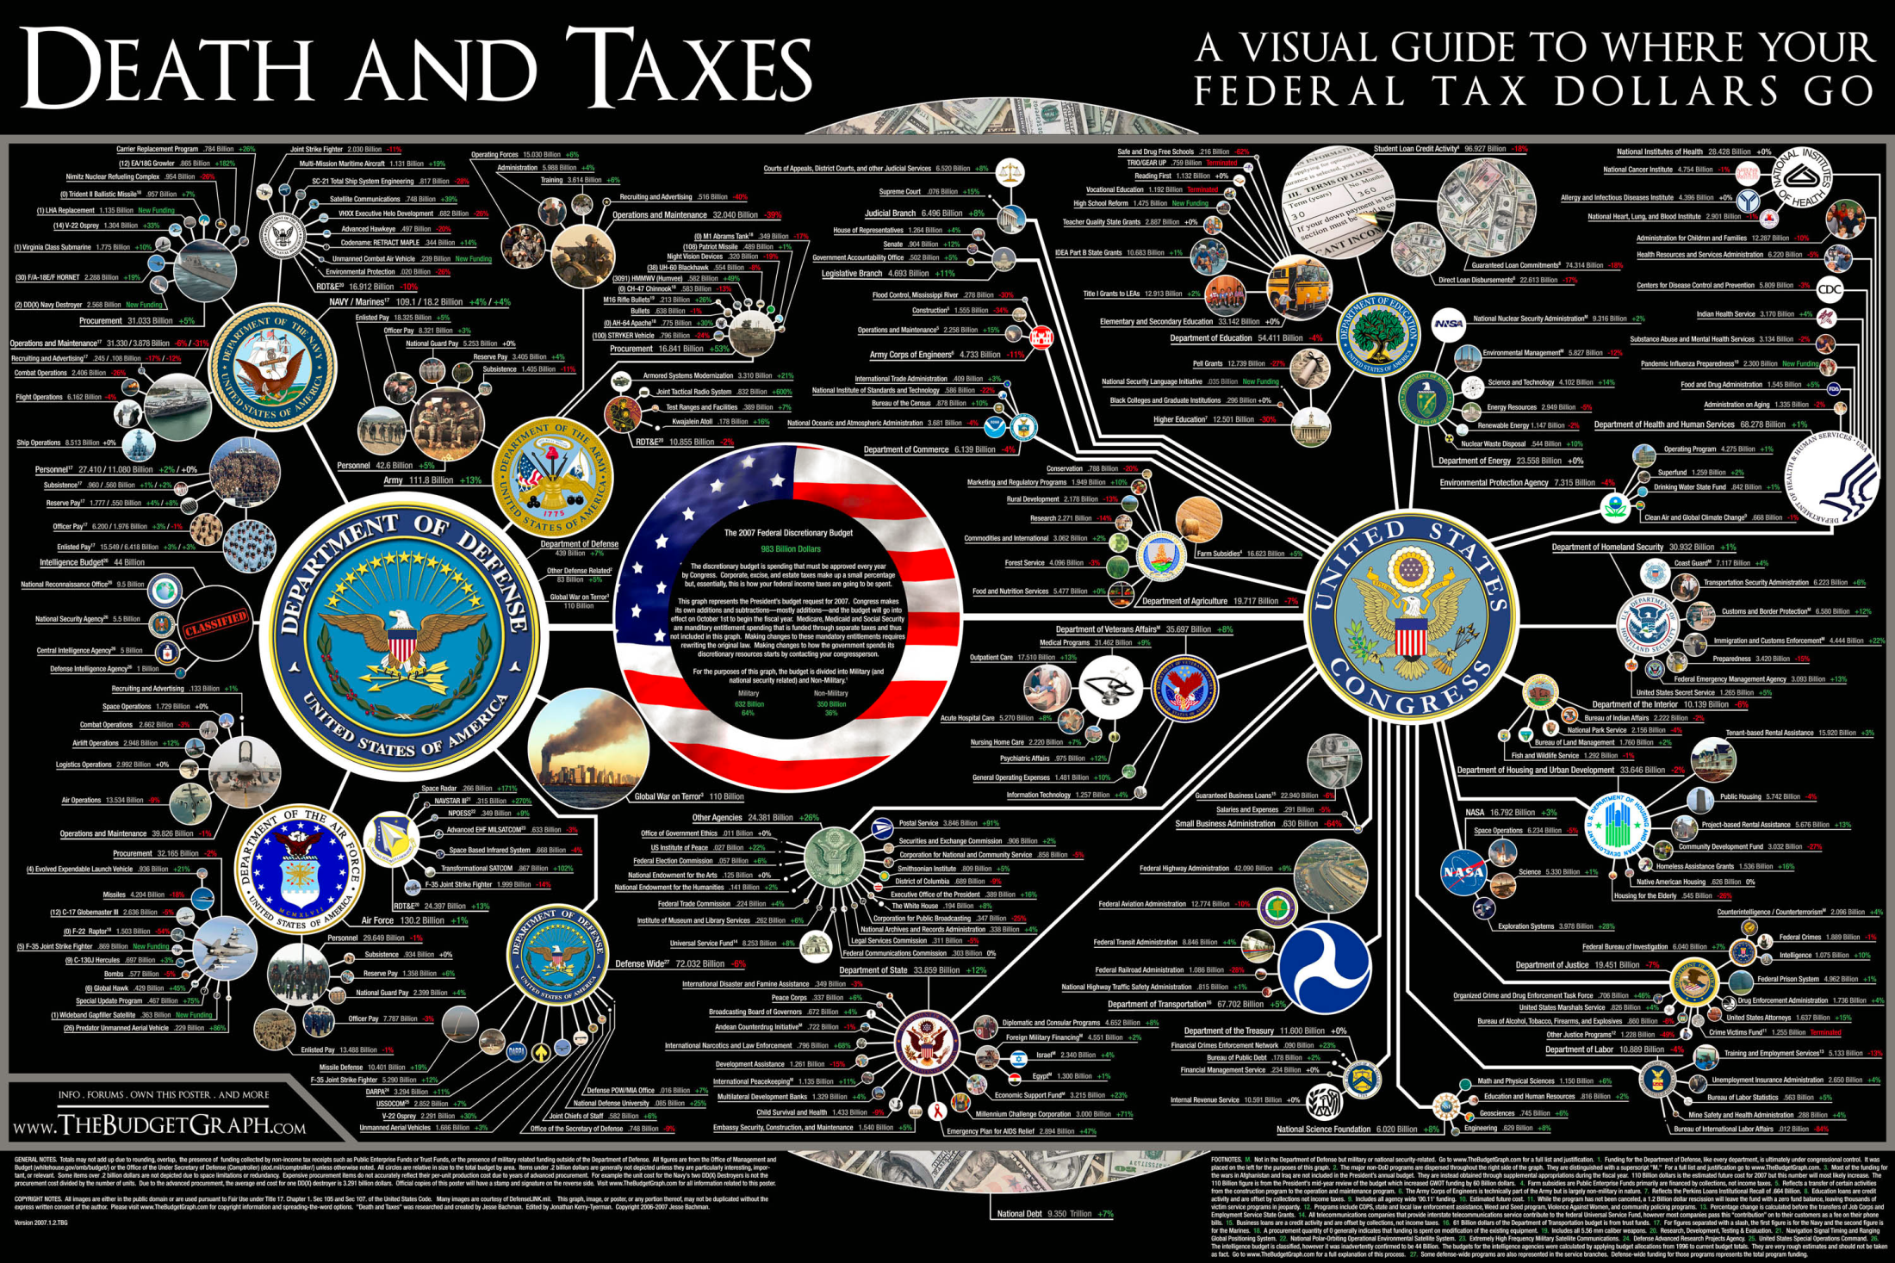
http://www.deathandtaxesposter.com/

Slide 44
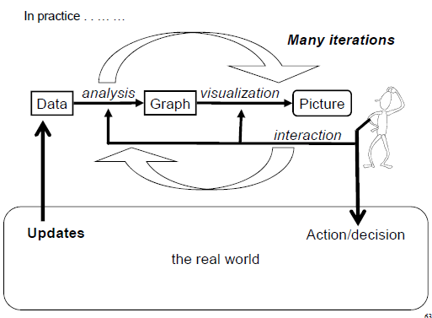
Interaction Flow in Graphs
Details from this slide borrowed from Peter Eades’ “The Future of Graph Drawing – and a rhapsody” lecture: http://sydney.edu.au/engineering/it/~peter/downloads.html

Slide 45
Using Interaction
By using interaction, we can reduce the computational complexity
The layout is only computed for the key frame (can be a relatively small graph in comparison)
Can use the time that the user is thinking about the visual to compute
This also reduces the visual complexity!
However, this can increase the cognitive complexity
The user must remember things from key frame to key frame

Slide 46
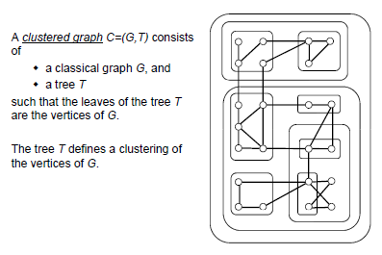
Clustered Graphs
Details from this slide borrowed from Peter Eades’ “The Future of Graph Drawing – and a rhapsody” lecture: http://sydney.edu.au/engineering/it/~peter/downloads.html
Notes:
Combining 2 layouts. Graphs + Trees

Slide 47
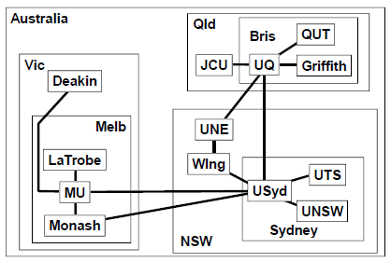
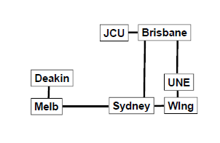
Clustered Graphs
For a huge graph, we can only realistically draw a small part at a time
The question is, which part?
We want to form an abstraction of the dataset
Details from this slide borrowed from Peter Eades’ “The Future of Graph Drawing – and a rhapsody” lecture: http://sydney.edu.au/engineering/it/~peter/downloads.html

Slide 48
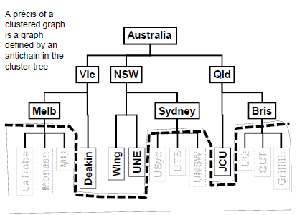
Clustered Graphs
Details from this slide borrowed from Peter Eades’ “The Future of Graph Drawing – and a rhapsody” lecture: http://sydney.edu.au/engineering/it/~peter/downloads.html

Slide 49
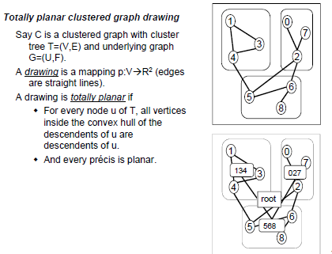
Totally planar clustered graph drawing
Details from this slide borrowed from Peter Eades’ “The Future of Graph Drawing – and a rhapsody” lecture: http://sydney.edu.au/engineering/it/~peter/downloads.html

Slide 50
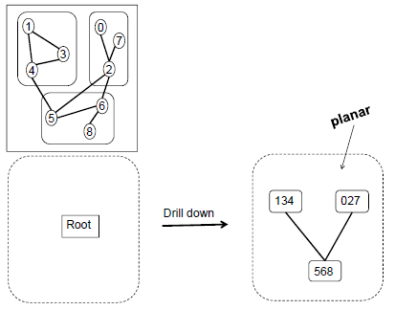
Totally Planar Clustered Graph Drawing
Details from this slide borrowed from Peter Eades’ “The Future of Graph Drawing – and a rhapsody” lecture: http://sydney.edu.au/engineering/it/~peter/downloads.html
Notes:
Get a planarity on a high level.

Slide 51
Interaction in Clustered Graphs
The basic interaction with a clustered graph is to drill down
See what a node contains, move a node to reorganize
Replace a node with its children
We also want to drill up
Close a set of nodes to make the picture simpler
Replace a set of siblings with their parent
In a practical systems
Human does drill-down
System does drill-up
Details from this slide borrowed from Peter Eades’ “The Future of Graph Drawing – and a rhapsody” lecture: http://sydney.edu.au/engineering/it/~peter/downloads.html

Slide 52
Implications of Interaction
Drilling down changes the size of a node, zooms in
Drilling up is performed by the system, but needs to preserve mental model
Nodes must move to accommodate these changes in size
The new picture must also conform to all the aesthetic constraints
The mental map must be preserved
Preserve orthogonal ordering
Preserve proximity
Preserve topology
Details from this slide borrowed from Peter Eades’ “The Future of Graph Drawing – and a rhapsody” lecture: http://sydney.edu.au/engineering/it/~peter/downloads.html

Slide 53
Art and Visualization
George Birkoff, 1933:
Beauty can be measured as a ratio of M=O/C
O = order ~ Kolmogorov complexity
C = complexity ~ Shannon complexity
If graph drawing is trying to optimize some aesthetic criteria, can we optimize beauty?
Notes:
We can decide which parameters to optimize.

Slide 54
Readings and Homework
Required Reading:
Ivan Herman, Guy Melanon, and M. Scott Marshall. 2000. Graph Visualization and Navigation in Information Visualization: A Survey. IEEE Transactions on Visualization and Computer Graphics 6, 1 (January 2000), 24-43
Adam Perer and Ben Shneiderman: Integrating Statistics and Visualization for Exploratory Power: From Long-Term Case Studies to Design Guidelines, IEEE Computer Graphics & Applications 29, 3 (May/June 2009), 39-51
M. Wattenberg, "Visual exploration of multivariate graphs," Proceedings of ACM CHI '06, Montreal, Canada, April 2006, pp. 811-819.

